Slide 1

Online Handicraft Retailer Pricing – A Case Study

Slide 2
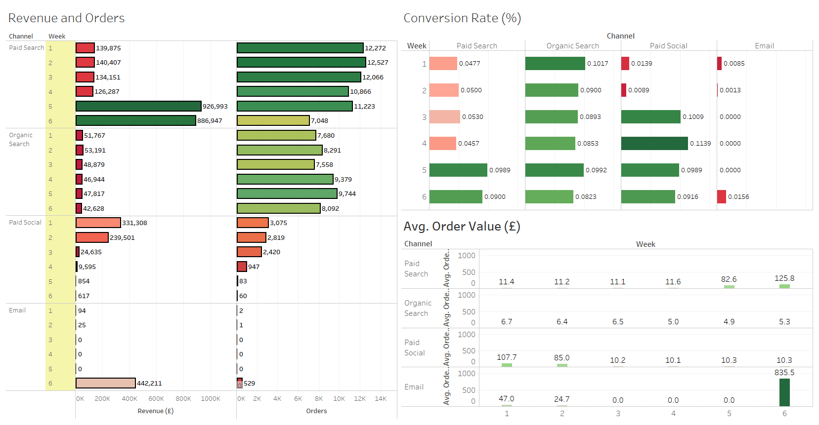

Slide 3
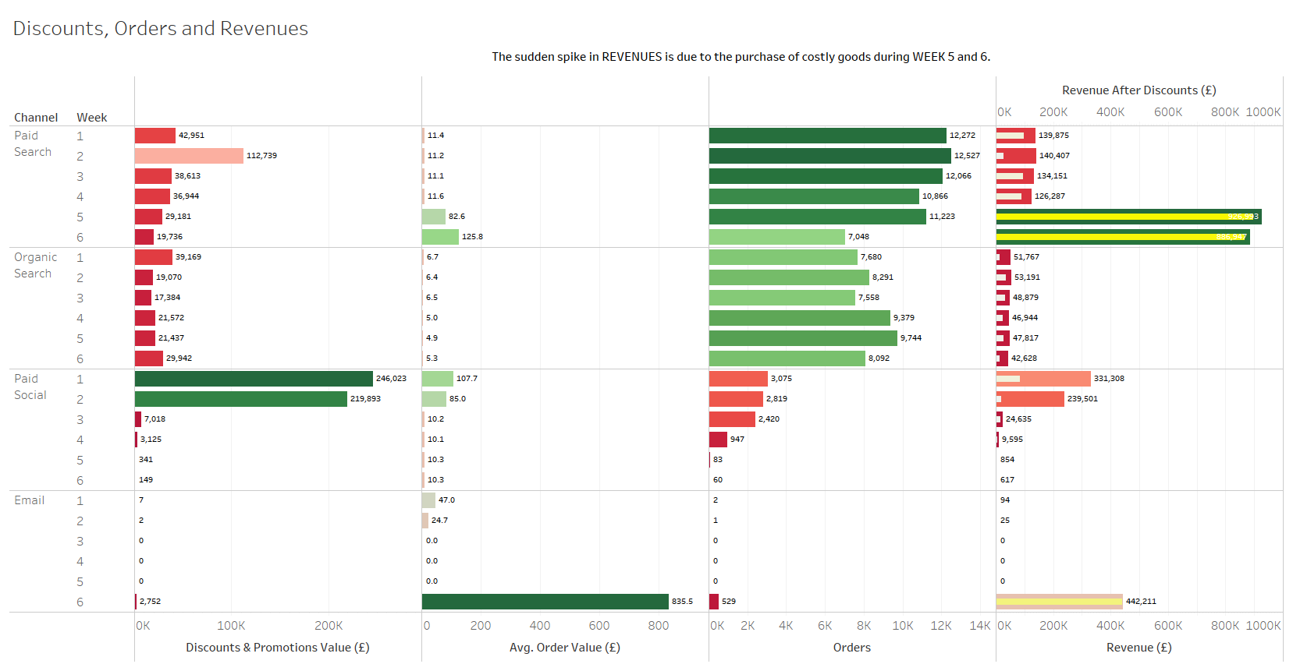

Slide 4
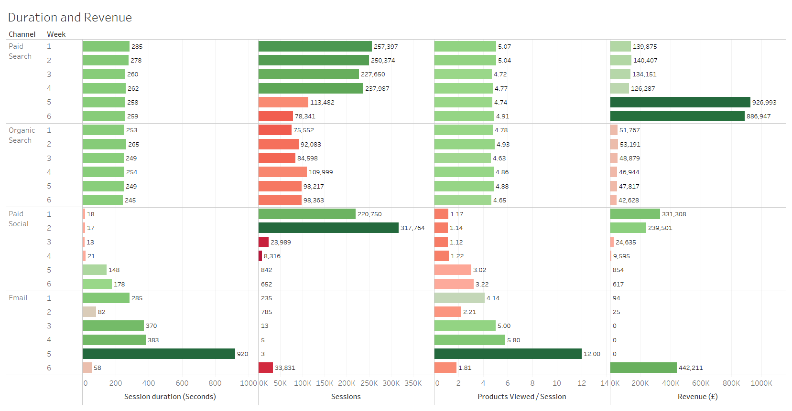

Slide 5
